Slide 1

Topic 03
HTML Fundamentals
Web Foundations
PROG1247
Prof. Andria Vanezi

Slide 2
Course Outcomes
Distinguish between the principles of content and presentation
Explain the principles of semantic HTML and CSS.

Slide 3
Webpage
Web page is a document commonly displayed in a web browser and typically accessed through a web address (URL)
Fundamental component of the World Wide Web and serves to present information, multimedia content, and interactive elements to users

Slide 4
What is a Website ?
A website is a collection of related web pages that are typically identified by a common domain name and are accessible over the Internet. It is a location on the World Wide Web that is made up of various elements, including text, images, multimedia content, and interactive features. Websites are designed to serve a specific purpose or convey information to users.

Slide 5
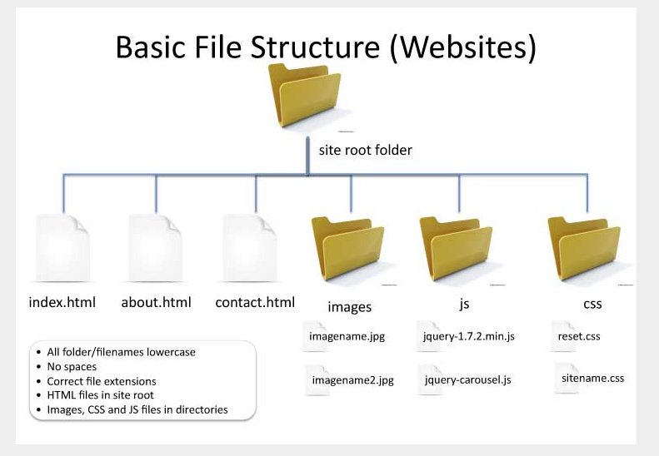
File Structure

Slide 6
Notes re: website file and folder structure
Files (“assets”, “resources”) that make a website:
Web pages, stylesheets, images, audio and video files, javascript files, pdf files, etc
Website files are organized into folders, and often subfolders as well
A website’s root folder contains all files and subfolders with resources
Be aware of the folder structure when working on web pages:
Location of files (on web server or your local computer) determines the path that we use for referencing these files (resources) in a web page

Slide 7
Introduction to HTML & CSS
HTML and CSS are the languages we use to web pages.
HTML = HyperText Markup Language
It is a markup language that gives structure to the content of a web page
For example, by marking a text as a paragraph, or as a heading, etc.
Hypertext is ‘text with hyperlinks’. Hyperlinks are links (words or image) that we can click on to go to and view a new document or a different section within the same document.
Most basic building block of the Web.
HTML is the basis of a web page, and a web page is the basis of a website.
HTML5 is the latest version of HTML and the one we will be using.
HTML is a very evolving markup language. It was developed in the 90s, and since then has changed, evolved a lot and through different versions - from HTML 1 to HTML5, to allow for easier, more advanced, and more efficient web development.
CSS = Cascading Style Sheets
Used to control the presentation of the content of a web page.
HTML is the first language of web development. CSS is used along with HTML to further improve the design of web pages. JavaScript is used along with HTML to make web pages dynamic, more interactive.

Slide 8
HTML & CSS: Content vs. Presentation
HTML and CSS are the two languages we use to create web pages.
Web servers store and serve HTML and CSS files.
Browsers requests HTML and CSS files and render web page content based on the HTML and CSS code received from the web server.
HTML is a markup language that gives structure to the content of a web page. It tells the browser “what’s what” on the page (a heading, a link, a paragraph, a list, an image, etc)
HTML is the first language of web: was NEVER intended to contain elements for controlling design of the content.
CSS is used to control the presentation of HTML elements in a web page. It sets the page content layout, background colour, text colour, font-size, font-family, spacing between different elements, borders - and many other properties (aspects) of elements in a web page.
CSS is used to define styles (look) for web pages – and this includes the design, layout and variations in display for different devices and screen sizes.
CSS is a style sheet language that is used to provide design to web pages.

Slide 9
The Basic Structure of an HTML Document
All valid HTML documents need to have:
A Document type declaration as its first line. It tells the browser which version of HTML the document is using.
The <html> element - coded right after the declaration; this is the root element, holding all other elements on the page. It also tells the browser that your document is an HTML document.
The <head> and <body> elements inside the <html> element.
The <head> element is where we put information about the web page – its metadata, as well as the links to the resources used by the page. Ex. page title, character set used, styles, stylesheets, scripts, etc. What you code in <head> is not visible in browser, except for title.
The <body> element is where page content goes and what is visible in the browser.
Nesting of HTML Elements:
Coding one element inside another element is called “nesting”.
Many HTML elements can have other HTML elements added between their tags, and then those as well (their ‘children’) can have other elements nested inside them, and so on.
Correct nesting: ‘inner’ elements are closed before ‘outer’ elements.

Slide 10
Nesting Elements ^{[1]}
Putting elements inside other elements.
Here is an incorrect nesting example:
<p>My cat is <em>very</em> grumpy.</p>
<p>My cat is <em>very grumpy.</p></em>

Slide 11
Accessible Webpage
Think about accessibility from day one.
Overtime, writing accessible websites will become a habit, not just some rules that you need to follow.
It is much harder to “update” a website to be accessible than to build one with accessibility in mind from the beginning
Follow the standards when coding.
HTML standards, ie. write valid HTML
Web Content Accessibility Guidelines (WCAG)
There is also a WAI specification for Accessible Rich Internet Applications (WAI-ARIA), which include dynamic content and advanced user interface controls developed with Ajax, JavaScript, and related web technologies.
Tips to get started:
Ensure the Document Object Model (DOM) structure is set up correctly to ensure:
The Webpage is Keyboard Accessible: All page functionality is available using the keyboard.
The webpage is compatible with screen readers
Try NVDA for free
The web page has a descriptive and informative page title.
Use Semantic elements to set up the structure of the page to create landmarks
Avoid the use of Grouping element such div or span tags unless there is not a semantic tag that is appropriate
The reading and navigation order (determined by code order) is logical and intuitive.
Semantic markup is used to designate headings, lists, emphasized or special text (code, quotes)

Slide 12
Document Object Model (DOM)
Web page is a document that can be either displayed in the browser window or as the HTML source
In both cases, it is the same document, but the DOM representation allows it to be manipulated
Data representation of the objects that comprise the structure and content of a document on the web
Programming interface for web documents
Represents the page so that programs can change the document structure, style, and content
Represents the document as nodes and objects; that way, programming languages can interact with the page
As an object-oriented representation of the web page, it can be modified with a scripting language such as JavaScript

Slide 13
The DOM
Document: When a member returns an object of type document, this object is the root document object itself
Node: Every object located within a document is a node of some kind.
In an HTML document, an object can be an element node but also a text node or attribute node.
Element: HTML elements
Elements have Attributes

Slide 14
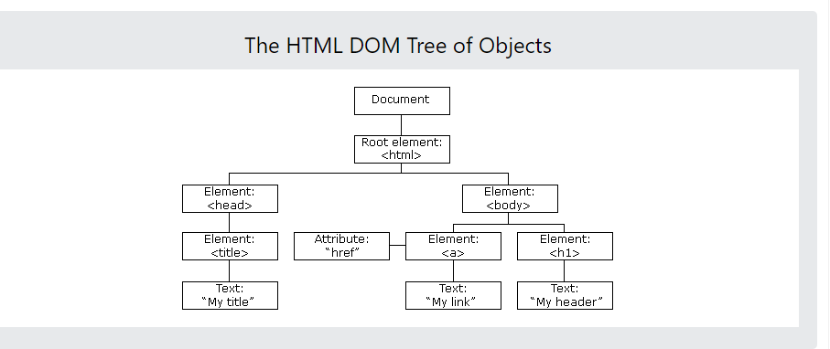

Slide 15
Landmarks
With landmarks, blind users using a screen reader can jump to sections of a web page.
In HTML there are some semantic elements that can be used to define different parts of a web page:
<header>
<nav>
<main>
<aside>
<section>
<footer>
When more than one landmark use the ARIA aria-label attribute

Slide 16
Roles
Each landmark element has a corresponding role
simplified explanation:
A <header> has a built in role of banner. This means that both <header>, <header role="banner"> and <div role="banner"> are more or less equivalent.
For most cases, <header> will be sufficient.
The same is true for <nav>, which has role="navigation" built in.

Slide 17
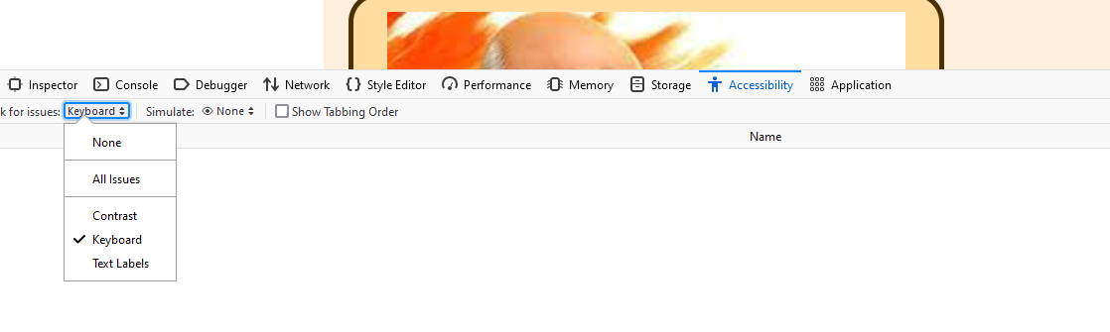
Firefox - Accessibility
Testing - Keyboard

Slide 18
The HTML head Element^{[1]}
The content in the head of the HTML document is not displayed.
The head tag contains information about:
the web page’s properties, like the title of the page, meta-information, etc.
links to CSS, JS, favicons, etc.
Information contained in the <head> tag is important to render the page properly in the browser.
Contains important SEO information like the title of the page, keywords and description.

Slide 19
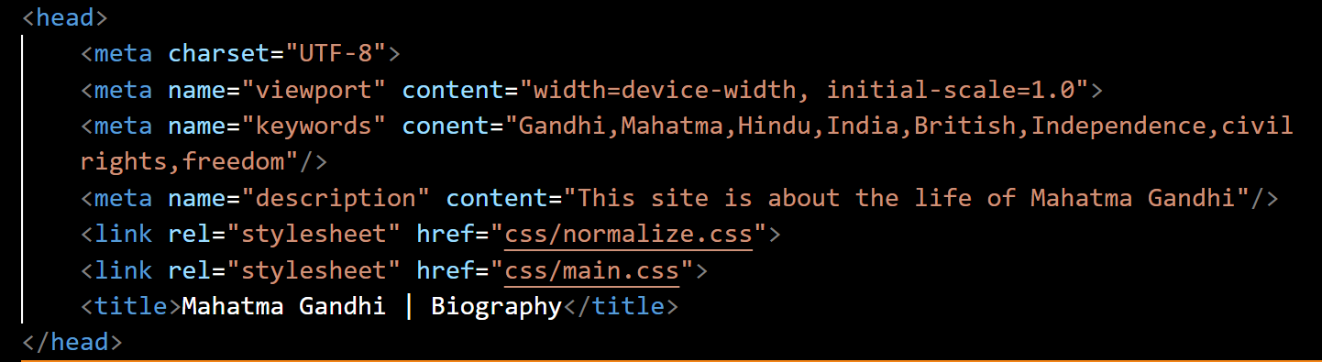
Head Element – Meta, Title

Slide 20
Meta Tags: Search Engine Optimization (SEO)
Optimize meta tags:
Meta tags provide information about a web page to search engines. Use descriptive and relevant meta titles and descriptions that include keywords to improve the page's visibility in search results.
Limit the length of your meta tags descriptions to around 160 characters
Guidelines (SEO) for the title tag
Always code a title tag in the head section.
The title should accurately describe the page’s content, and it should include the one or two keywords that you want the page to rank for in search engines.
It should be interesting enough to entice the reader to click on it when it’s shown in the search results for a search engine.
It has to be unique for each page on your website.
Limit the length of your titles to around 65 characters because most search engines don’t display more than that in their results.

Slide 21
HTML elements
The main building blocks of HTML are HTML elements. They are also often referred to as HTML tags.
HTML elements add structure to the content by telling the browser how to display the content
An HTML element is composed of three parts: an opening tag, content, and a closing tag. Closing tags have a “/” after the left angle bracket, in front of the tag name, to distinguish them as closing tags.

Slide 22
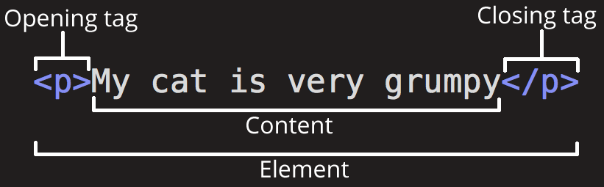
HTML Syntax
Opening Tag:
Name of the element
Written using opening and closing angle brackets.
Content: The actual data.
Closing Tag:
Includes a forward slash before the name of the tag
Written using opening and closing angle brackets.
Not all tags have closing tags. Eg: <img>
HTML tags are not case sensitive: <P> means the same as <p>. However, it is considered a bad practice to use a mixed case. The coding practice we will follow is to use lower case when coding HTML tags.
Empty Elements
HTML elements that do not have any content.
Also referred to as void elements.
Figure 1. Anatomy of an HTML element from MDN Web Docs, 2020. Licensed under CC BY-SA 2.5
<p>My cat is very grumpy</p>
<img src="images/my_photo.png" alt="My Photo">

Slide 23
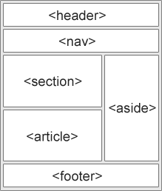
Semantic Elements
A semantic element clearly describes its meaning to the browser, developer, search engines. Semantic elements are about making HTML markup more intuitive, more descriptive of the content they hold.
Examples of semantic elements: <p>, <h1>, <form>, <table>, <article>, etc. - they clearly define their content.
Examples of non-semantic elements: <div>, <span> - they tell nothing about their content.
HTML5 offers some new semantic elements to define parts of a web page.
<div> elements used to be used for organizing the layout of the content on a page, by grouping the elements together – until HTML5 semantic elements like <header>, <nav>, <section>, <aside>, <footer>, etc. came along. These semantic elements have replaced <div> in that sense.
HTML5 semantic elements are supported in all modern browsers. In this course we will use HTML5 semantic elements – rather than <div> elements – to build structure (layout) of content on a web page (see the image on the right as an example)

Slide 24
The <aside> and <section> tags
Two of the elements that people find vaguely defined are <aside> and <section>
Let us try to clarify a bit.
The big difference is that an <aside> is related to the main content and the <section> is not related.

Slide 25
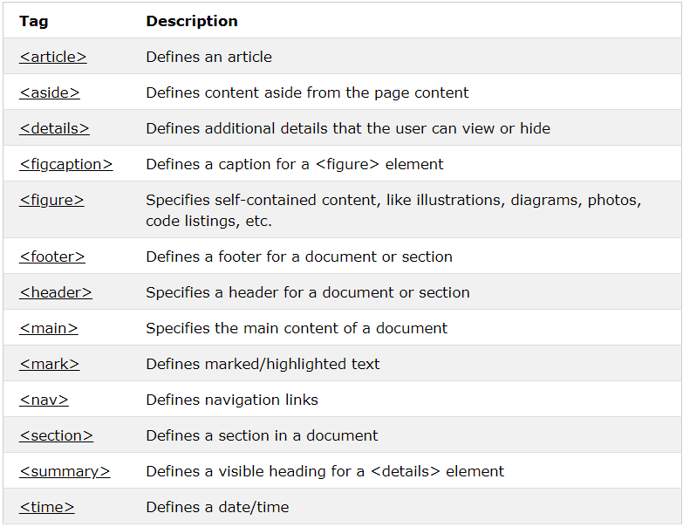
HTML5 Semantic Elements

Slide 26
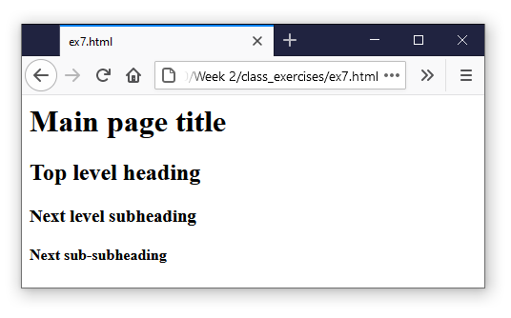
Headings, Paragraphs, Line Breaks
Paragraphs are defined with the <p> element.
<p>This is a (very short) paragraph.</p>
Used for creating paragraphs of text on the page.
Line Breaks are used to add a break, a new line to content of a web page.
They are inserted using <br> element.
Headings are defined with the <h1> to <h6> tags.
<h1> defines the most important heading. <h6> defines the least important heading.
<h1> headings should be used for the main heading on a page, followed by <h2> headings, then the less important <h3>, and so on.
<h1>Main Heading</h1>
Headings are important:
It is important to use headings to show the content structure, from the usability perspective.
Visitors often skim a page by its headings – and leave quickly if they conclude they can’t find what they are looking for
Search engines (like Google, Bing, etc) use the headings to index the content of your web pages.
Every web page needs to have exactly one <h1> element – no zero, and no more than one.
<p>This is a single paragraph</p>
<h1>Main page title</h1>
<h2>Top level heading</h2>
<h3>Next level subheading</h3>
<h4>Next sub-subheading</h4>
Output showing the use of different heading tags.

Slide 27
Headings: Good coding practices
Use the heading tags to show the structure and importance of the content on a page.
Always use the h1 tag to identify the most important information on the page, and only code a single h1 tag on each page.
Then, decrease one level at a time to show subsequent levels of importance. Keep h1 heading text unique from page to page.
Use header tags: Header tags (H1, H2, H3, etc.) provide structure and hierarchy to a web page.
Using header tags can help search engines understand the content of a page and improve the page's ranking in search results
Useful for Accessibility and Useability

Slide 28

Attributes ^{[2]}
Used for additional information about the elements.
Do not show up on the screen to the user.
Example code to add a class “editor-note” to the previously defined <p> tag:
<p class = "editor-note">My cat is very grumpy</p>
Figure 2. Attributes in an HTML element showing the use of class attribute in a <p> tag.
Note. Mozilla Contributors, 2020. CC BY-SA 2.5

Slide 29
id and class attributes
The class attribute:
can be coded for any HTML element
multiple HTML elements can share same class
used to apply same formatting (design) to all HTML elements that share the same class name
an HTML element can have multiple classes, in which case they are separated by commas
The id attribute:
specifies a unique id for an element inside an HTML document; it’s unique to that element which means that the same id cannot be shared by multiple elements, in one HTML document.
can be coded for any HTML element
used to apply CSS styles to an HTML element by using the element’s id attribute to reference it.
an HTML element can have only one id
Any HTML element can have both id and class attributes added to it.
Difference between class and id: A class name can be used for multiple elements, while an id is used for one element only (i.e. it must be unique on a page)
Naming convention we will be using in this course: no spaces, starting with a letter, with a dash in between words, lower-case Example: <p class=“important-text” id=“intro”>This is a sample paragraph.</p>

Slide 30
Block and Inline Elements ^{[2]}
Block element
Creates a block on a page, that appears in a new line.
Takes all the width that is available from the left to the right of the parent element.
Pushes the content that appears after it to the next line.
Generally, is a structural element on the page like headings, navigation, footer, etc.
Inline element
Only occupies the space required by the content in it.
Generally contained inside a block element.
Does not produce new lines on the page.
Mostly used with text to style it or for semantics like <em> or <strong>.
<p>first</p> <p>second</p> <p>third</p>
<em>first</em> <strong>second</strong> <em>third</em>

Slide 31
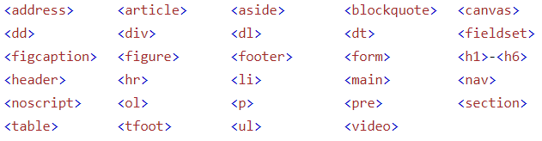
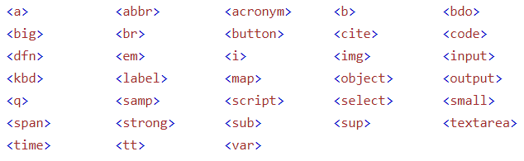
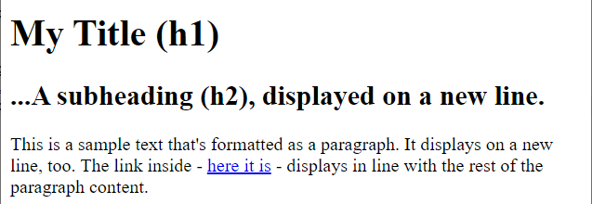
Block and Inline Elements
Every HTML element has a default display value depending on what type of element it is. The two most common display values are: block and inline.
A block element always starts on a new line and takes up the full width available (stretches out to the left and right as far as it can). Block elements stand on their own.
An inline element does not start on a new line and only takes up as much width as necessary. Inline elements appear “in line” within the flow of the text in your page. They go with the flow.

Slide 32
HTML ‘Grouping’ Elements: <div> and <span>
The <div> element:
is often used as a container for other HTML elements; it is a block element
before HTML5 it was regularly used for creating page layout (eg. main section, footer, header, main menu, side menu)
when used together with CSS, the <div> element can be used to style blocks of content
it has no required attributes, but style, class and id are commonly used attributes with it
Example:
<div id=“main-content”>
<h1>This is the main title for the page</h1>
<p>Some text, displayed as a paragraph</p>
<p>…. And then some more content would go here</p>
</div>
The <span> element:
is often used as a container for some text; it is an inline element
it has no required attributes, but style, class and id are commonly used attributes with it
when used together with CSS, the <span> element can be used to style parts of text
Example:
<h1>My <span id=“main-title”>2-coloured</span> heading</h1>

Slide 33
Whitespaces ^{[2]}
Whitespace (tabs, returns, spaces) is ignored by the browser
You cannot add whitespace to your content by using keyboard (tabs, returns, spaces) as the browser ignores it all when displaying the page.
You can use whitespace to make your HTML code more readable (to you and everyone else). Using whitespace and indentation is considered a good coding practice and the one we will follow in this course as well.
In HTML any number of consecutive white spaces are counted as one single space.
Here are two examples of code that produce the same result when displayed in a browser:
<p>Dogs are silly.</p>
<p>Dogs are
silly.</p>

Slide 34
Text Markup: HTML Comments ^{[1]}
To help other developers on your team to understand your code.
Also helpful in maintaining your code in long term.
HTML comments are written using special markers <!-- and -->.
HTML comments do not show up in the body of the browser when the page loads.
<p>This is not in a comment.</p>
<!-- <p>This is in a comment and will not show up.</p> -->
Adding comments in HTML: Anything you place in between <!-- and -->, including HTML code, will be ignored by the browser.
Comments can help document your HTML source code.
Comments can also help you debug your code.
Example: <!– This is a comment -->

Slide 35
Good Coding Practices
Good coding practices that we will follow in this course:
Following the HTML coding standards (you will learn them as we go through the course)
Writing easy to read, follow and maintain code, by using:
Proper code indentation
Use of White space for breaking code into sections, making it easier to read
Code commenting for the purpose of explaining the purpose of the code in question
Correct, optimal, concise and clean code
Using lower-case for HTML tags
File naming conventions: lower-case, no spaces, dashes in between words (ex. hello-world.html)

Slide 36
Benefits of CSS
CSS is used along with HTML to further improve the design of web pages
CSS solved a huge problem by removing design elements from the HTML page, leaving the HTML markup clean of the formatting tags.
CSS saves a lot of work: The styles are usually saved in external .css files, stylesheets. Setting up a stylesheet takes time, but once it’s done, you can change the look of an entire website by changing just one file, the styelsheet!

Slide 37
Adding CSS to HTML
Browser Defaults^{[2]}
Here is a very good video that explains browser defaults in detail: https://youtu.be/spK_S0HfzFw
Reset Browser Defaults
Here are the links to two CSS resets that you can use (as mentioned in the video):
Eric Meyer’s CSS Tools: Reset CSS
Normalize CSS

Slide 38
normalize.css stylesheet
What does normalize.css stylesheet do?
Normalize.css is a stylesheet that makes minor adjustments to browser default styles so that all browsers render HTML elements the same way.
For instance, the normalize.css stylesheet sets the margins for the <body> of the document to zero so there is no space between <body> and the edge of the browser window.
It also sets the default font-family for the document to sans-serif.

Slide 39
Three types of CSS ^{[3]}
Types of CSS (by location and scope)
Inline
Internal/Embedded
External

Slide 40
External CSS Filles
There are External, Embedded and Inline CSS.
External CSS
CSS rules are specified in an external file, which we call stylesheet.
Stylesheets are text files (can be written in a text editor) saved with .css extension; ex. myStyles.css
The stylesheet file is then referenced (included) in the HTML page to which we want to apply the styles (CSS rules), by adding a <link> element inside the <head> element:
<head> <link rel="stylesheet" type="text/css" href="mystyles.css"> </head>
.css files should not contain any HTML tags.
By using a stylesheet (ie. by having all your CSS styles specified in the file), you can change the look of an entire website by changing just the stylesheet file.
Stylesheets are the common approach for specifying CSS rules.
A website can use one or multiple stylesheets.

Slide 41
External CSS
<!DOCTYPE html>
<html>
<head>
<meta charset="utf-8">
<title>External CSS</title>
<link rel="stylesheet" href="path_to_file/style.css">
</head>
<body>
<p>This is a paragraph. </p>
<p>This is another paragraph. </p>
</body>
</html>
p{
color: red;
}
CSS file: style.css
HTML file: index.html

Slide 42
Types of CSS (by location and scope), Cont’d
Embedded CSS
Embedded CSS is coded inside the <head> section of an HTML page, within the <style> element: <head> <style> body {background-color: green;} </style> </head>
Embedded CSS might be used if there is a need for a particular web page to have a look different from other pages.
Should be used with caution – it makes updating design more difficult
Inline CSS
Inline styles are coded within the style attribute of the relevant HTML element:
<p style="color: red; font-size: 14px;">This is a paragraph.</p>
Inline CSS may be used to apply a unique style for a single element.
Should be used sparingly, as it clutters HTML and makes maintenance updates more difficult

Slide 43
Embedded / Internal
<html>
<head>
<meta charset="utf-8">
<title>Internal CSS</title>
<style>
p {
color: red;
}
</style>
</head>
<body>
<p>This is a paragraph. </p>
<p>This is another paragraph. </p>
</body>
</html>

Slide 44
Inline
<!DOCTYPE html>
<html>
<head>
<meta charset="utf-8">
<title>Inline CSS</title>
</head>
<body>
<p style="color:red;">This will appear in red.</p>
<p>This will not appear in red.</p>
</body>
</html>

Slide 45
CSS: Order in which styles are applied
- We’ve seen that there can be different sources of CSS styles.
- If there is more than one rule specified for one same property of a specific element - which one will be applied? Let’s say the colour for <h1> heading is defined in all three CSS types: internal, external and embedded, and they all use a different colour. In addition, browser’s default colour for <h1> is black. What colour will be used for the heading when the page is displayed?
- If rules in different styles conflict with one another, the rule with the higher priority wins. - CSS styles are applied in the following priority order - #1 being the highest priority:
Inline CSS (inside an HTML element, in the style attribute)
External and embedded CSS – the priority between them will depend on which one comes later in the head section: the later one has a higher priority
Browser’s default CSS
Having the highest priority, the Inline styles will override external and embeded styles as well as browser defaults.

Slide 46
CSS – Rulesets
CSS rulesets style the HTML elements as defined by the declarations written in the rulesets.
A CSS ruleset (normally called just rule) targets an HTML element using a selector and defines its appearance.
p{
color: red;
}

Slide 47
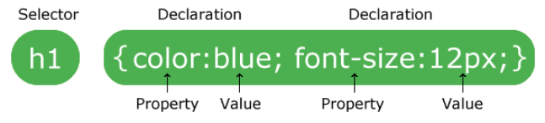
CSS Syntax
A CSS RULE SET consists of a SELECTOR and a DECLARATION BLOCK.
A selector points to the HTML element you want to style.
A declaration block is surrounded by curly braces. It contains one or more declarations.
Each declaration includes a CSS property name and value, separated by a colon.
Property is what is being changed and value is how the property is being changed.
A declaration always ends with a semicolon.
The way we will use indentation and alignment within CSS code in this course – example:
h1 { color: blue; font-size: 12px; }
Adding comments in CSS: /* This is how you would add comments to CSS. Comments are ignored by browsers. They are used for code documentation purposes. */
“Have all h1 elements on the page appear in blue and with the font size of 12 px”

Slide 48
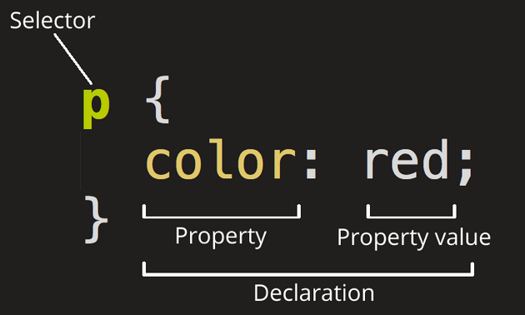
CSS Rulesets: Properties and Values^{[1][2]}
CSS ruleset:
Selectors
Declarations
CSS declaration:
Property
Value
For example, to change a property ‘color’ of a paragraph so that it appears in ‘red’ (value) colour, the declaration is written as:
color: red;

Slide 49
Example: Writing a CSS ruleset
In this example, there are 2 declarations:
color: red;
font-weight: bold;
p{
color: red;
font-weight: bold;
}

Slide 50
Comments, White Space and Indentation ^{[3]}
Just like HTML, we can write comments in CSS too and also use white space for indentation.
Comments
White Space and Indentation
/* This is a CSS comment */
p{
color: red;
font-family: Arial, sans-serif;
font-weight: bold;
}

Slide 51
CSS Selectors^{[1]}
Selectors in CSS are used to target HTML elements on a web page for styling.
Types of Selectors
Type, Class and ID

Slide 52
Type, Class and ID ^{[2]}
Type: Selector that targets an HTML element using the tag names
The HTML code:
Corresponding CSS:
<h1>Test heading in green. </h1>
h1{
color: green;
}

Slide 53
Type, Class and ID ^{[2]}
ID: works much like the ‘Class’ selector with three key differences
One that the id is specified in the ‘id’ attribute of the tag,
Second that the CSS rule uses hash (#) along with the id as a selector
Third that only one id can be given to an element.
The HTML code:
Corresponding CSS:
<h1 id="specialHeading">Test heading will be underlined. </h1>
#specialHeading{
text-decoration: underline;
}

Slide 54
CSS
CSS stands for Cascading Style Sheets, and that first word cascading is incredibly important to understand — the way that the cascade behaves is key to understanding CSS.
cascade, and the closely-related concept of specificity, are mechanisms that control which rule applies when there is such a conflict. Which rule is styling your element may not be the one you expect, so you need to understand how these mechanisms work.
concept of inheritance, which means that some CSS properties by default inherit values set on the current element's parent element, and some don't.
Notes:
https://developer.mozilla.org/en-US/docs/Learn/CSS/Building_blocks/Cascade_and_inheritance

Slide 55
Cascade
Stylesheets cascade — at a very simple level, this means that the order of CSS rules matters; when two rules apply that have equal specificity, the one that comes last in the CSS is the one that will be used.

Slide 56
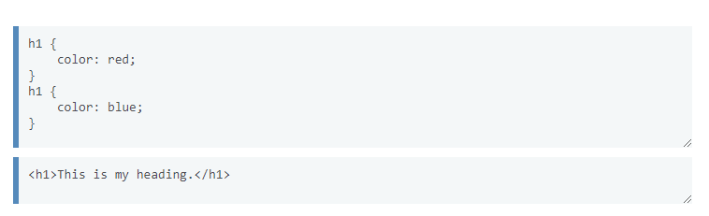
Cascade Example
In the below example, we have two rules that could apply to the h1

Slide 57
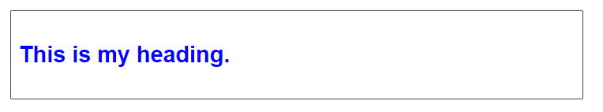
Blue
. The h1 ends up being colored blue — these rules have an identical selector and therefore carry the same specificity,
so the last one in the source order wins.

Slide 58
Specificity
Specificity is how the browser decides which rule applies if multiple rules have different selectors, but could still apply to the same element. It is basically a measure of how specific a selector's selection will be:
An element selector is less specific — it will select all elements of that type that appear on a page — so will get a lower score.
A class selector is more specific — it will select only the elements on a page that have a specific class attribute value — so will get a higher score.

Slide 59
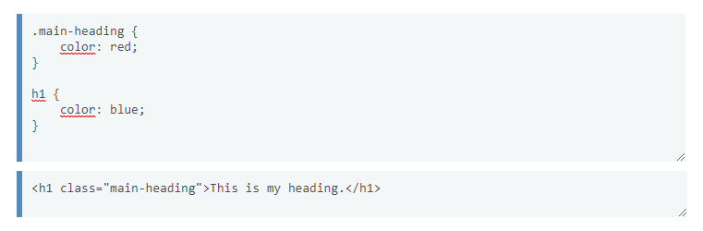
Specificity Example
Example time! Below we again have two rules that could apply to the h1. Which will be applied

Slide 60
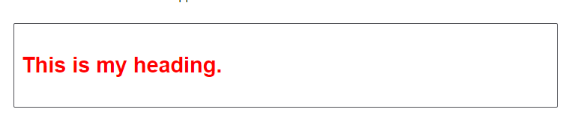
Red
The below h1 ends up being colored red — the class selector gives its rule a higher specificity, and so it will be applied even though the rule with the element selector appears further down in the source order.

Slide 61
Inheritance
Inheritance also needs to be understood in this context — some CSS property values set on parent elements are inherited by their child elements, and some aren't.
Some properties do not inherit — for example, if you set a width of 50% on an element, all of its descendants do not get a width of 50% of their parent's width. If this was the case, CSS would be very frustrating to use!
https://www.codecademy.com/resources/docs/css/inheritance

Slide 62
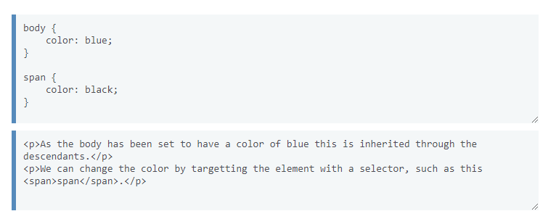
Inheritance Example
If you set a color and font-family on an element, every element inside it will also be styled
with that color and font, unless you've applied different color and font values directly to them.
What color will the word span be, what color is the rest of the sentence, will they be different?

Slide 63
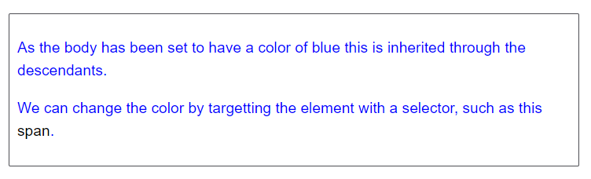
Black, blue, yes
For example, if you set a color and font-family on an element, every element inside it will also be styled with
that color and font, unless you've applied different color and font values directly to them.

Slide 64
How to identify a CSS rule as ‘important’ and what it means
When the !important rule is used with a style declaration, this declaration overrides any other declarations that are setting up the same property for the same element.
h2, p {
color: blue;
}
h2 {
color: red !important;
}
Using !important is not a good practice and should be avoided because it makes debugging more difficult by breaking the natural cascading order (order in which styles are applied) in your stylesheets.

Slide 65
CSS Cascade
CSS declarations can come from multiple stylesheets that come from different origins:
the User-agent stylesheets (ie. browser’s stylesheet; Browsers have a basic style sheet that gives a default style to a web page.)
the Author stylesheets (ie. Web developers’ stylesheets)
the User stylesheets (ie. a site visitor’s stylesheet); The user (or reader) of a website chooses to override styles in a browser by using a custom user stylesheet designed to tailor the experience to the user's wishes. Not as common these days, as different browsers are phasing them out.
The declarations (styles) from these different origins can overlap, in which case there could be potentially a conflict between rules. Ex. a browser’s default font-size for h1 is set at 22px, while the web developer’s stylesheet sets it at 25px.
The CSS Cascade refers to the order in which CSS declarations are applied to elements. This order is based on the ‘weight’ CSS rules have, as follows:
!important rules in a user style sheet (have the most weight)
!important rules in a developer’s stylesheet
Normal rules in developer’s stylesheet
Normal rules in a user style sheet
Normal rules in the web browser (have the least weight)

Slide 66
CSS Cascade, Cont’d
If more than one rule, from the same origin – that is, with the same weight, is applied to the same element, for one same property (for ex. multiple font-size styles within your stylesheet are targeting the h2 element), the rule set with the highest specificity is applied.
The specificity of a rule set is defined by its selector:
An id selector is the most specific
A class, attribute selector, or pseudo-class selector is less specific
An element or pseudo-element selector is least specific For ex. #highlight selector is more specific than the .highlight selector, and .highlight selector is more specific than div selector.
If the specificity is the same for two or more rule sets:
The rule set that’s specified last (ie. further down in the stylesheet) is applied
Exception re: the highest specificity rule: Directly targeted elements vs. inherited styles
Styles for a directly targeted element will always take precedence over inherited styles, regardless of the specificity of the inherited rule.

Slide 67
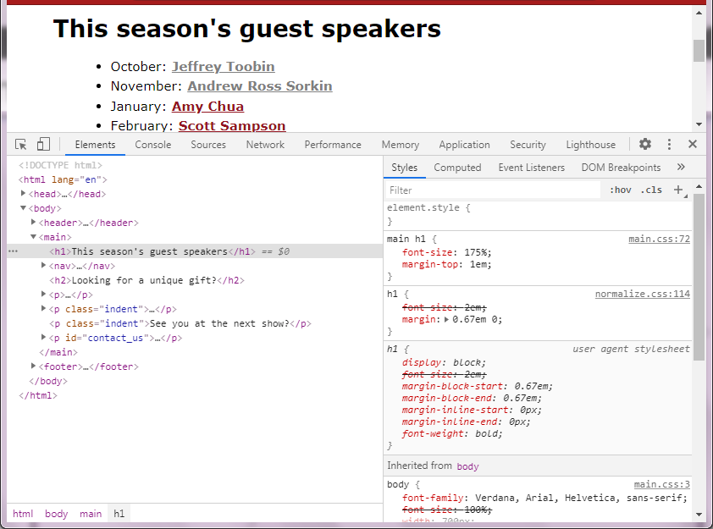
Cascading styles in Chrome’s developer tools
main h1 { font-size: 175%; }
This is the style that’s applied to h1
From the author stylesheet: main.css
The selector also has the highest specificity of all selectors from the author stylesheets
h1 { font-size: 2em; }
From the author stylesheet: normalize.css
Not applied because main.css is listed 2nd in <head>, after normalize.css
h1 { font-size: 2em; }
From the user agent (browser’s) stylesheet
Not applied because it has less weight than the author (developer’s) stylesheet
body { font-size: 100%; }
From the author stylesheet: main.css
The style is applied to the parent element, and so it is inherited by the decendent elements, including h1
Not applied since styles for a directly targeted element will always take precedence over inherited styles (no matter the specificity).

Slide 68
How to View and Troubleshoot the Source Code in the Browser
View HTML Source Code
Right-click on a web page and select "View Page Source" (in Chrome) or "View Source" (in Edge), or similar in other browsers. This will open a window containing the HTML source code of the page.
Inspect an HTML Element
Right-click on an element (or a blank area) in an HTML page and choose "Inspect"
Can see both HTML and the CSS code applied to an element.
Can also edit HTML and CSS on the fly in the Elements or Styles panel that open up with this option.
This is a valuable tool for troubleshooting and resolving issues with your code.

